Slide 1
CHAPTER – 4
DIGITAL TRANSMISSION

Slide 2
OUTLINE
Digital-to-digital conversion
  Line coding
  Block coding
  Scrambling
Analog-to-digital conversion
  Pulse code modulation (PCM)
  Delta modulation (DM)
Transmission modes
  Parallel Transmission
  Serial Transmission

Slide 3
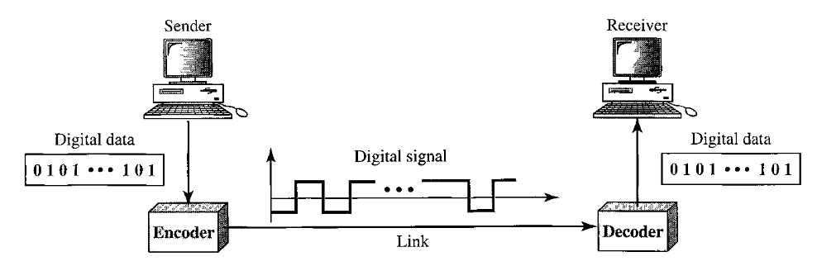
LINE CODING
Line coding converts a sequence of bits to a digital signal.
It is a process of converting digital data to digital signals.
Notes:
At page 101

Slide 4
DATA ELEMENT VERSUS SIGNAL ELEMENT
A data element is the smallest entity that can represent a piece of information: this is the bit.
A signal element carries data elements. A signal element is the shortest unit (timewise) of a digital signal.
In other words, data elements are what we need to send; signal elements are what we can send. Data elements are being carried; signal elements are the carriers.
We define a ratio r which is the number of data elements carried by each signal element.
r = data element / signal element
Notes:
At page 102

Slide 5
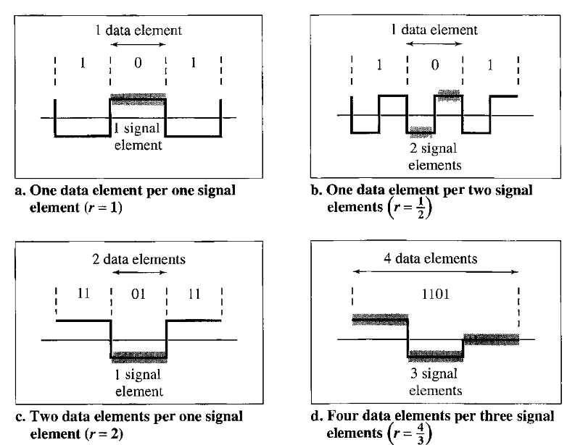
DATA ELEMENT VS SIGNAL ELEMENT

Slide 6
DATA RATE VS. SIGNAL RATE
Data Rate / Bitrate
  Number of bits sent in 1s.
  Unit is bps (bits per second).
Signal Rate
  Number of signal elements sent in 1s.
  Unit is baud.
  Also known as baud rate, modulation rate, pulse rate.
Goal in data communication is to increase the data rate while decreasing the signal rate. Increase ratio ( r ) !
Increasing data rate will increase the speed of transmission and decreasing signal rate will decrease the bandwidth requirement.

Slide 7

RELATIONSHIP BETWEEN DATA RATE & SIGNAL RATE
The relationship between data rate and signal rate can be expressed as
where
S = Signal rate
N = Data rate
r = ratio
c = case factor, different for each case

Slide 8
EXAMPLE
A signal is carrying data in which one data element is encoded as one signal element (r = 1). If the bit rate is 100 kbps/(100*10↑3)bps, what is the average value of the baud rate if c is between 0 and 1 ?
We assume that the average value of c is 0.5. The baud rate is then

Slide 9


RELATIONSHIP BETWEEN BANDWIDTH & SIGNAL RATE
Bandwidth (range of frequencies) is proportional to the signal rate (baud rate). The minimum bandwidth can be given as
We can solve for the maximum data rate if the bandwidth of the channel is given.

Slide 10

RELATIONSHIP BETWEEN BANDWIDTH & SIGNAL RATE
The maximum data rate of a channel is N_{max} = 2 x B x 1og₂L (defined by the Nyquist formula). Does this agree with the previous formula for N_{max}?
A signal with L levels actually can carry 1og₂L bits per level. If each level corresponds to one signal element and we assume the average case (c = 0.5), then we have

Slide 11
CAPABILITIES OF LINE CODING SCHEMES
Baseline wandering
DC component
Synchronization
Self-synchronization
Built-in error correction
Immunity to noise and interference
Complexity

Slide 12
BASELINE WANDERING(M:WALK OR MOVE IN LEISURELY)
In decoding a digital signal, the receiver calculates a running average of the received signal power. This average is called the baseline.
The incoming signal power is evaluated against this baseline to determine the value of the data element. A long string of Os or 1s can cause a drift in the baseline, called baseline wandering, and make it difficult for the receiver to decode correctly.
A good line coding scheme needs to prevent baseline wandering.
Notes:
At page 104

Slide 13
DC COMPONENT
When the voltage level is constant for a while in a digital signal, then the spectrum creates very low frequencies (result of Fourier Analysis). These frequencies around zero are called DC (Direct-Current) Components.
It presents a problem for a system that cannot pass low frequencies.
For example, a telephone line cannot pass frequencies below 200 Hz.
Notes:
At page 105

Slide 14
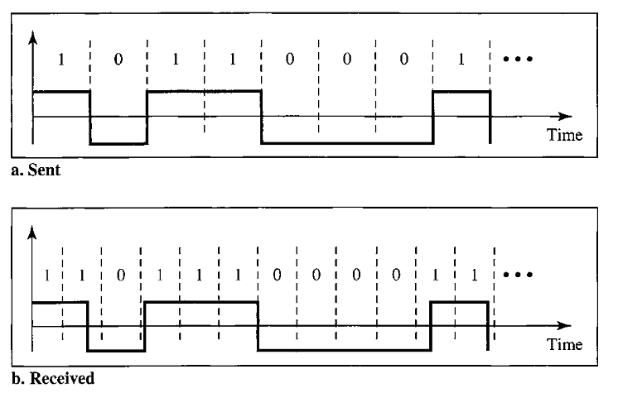
SYNCHRONIZATION
To correctly interpret the signals received from the sender, the receiver’s bit interval must correspond exactly to the sender’s bit interval.
That is, their clocks should be matched and synchronized

Slide 15
SELF SYNCHRONIZATION
A self-synchronizing digital signal includes timing information in the data being transmitted.
This can be achieved if there are transitions in the signal that alert the receiver to the beginning, middle, or end of the pulse.
If the receiver' s clock is out of synchronization, these points can reset the clock.

Slide 16
MORE CHARACTERISTICS
Built-in error detection
  It is desirable to have a built-in error-detecting capability in the generated code to detect some of or all the errors that occurred during transmission.
Immunity to Noise and Interference
  Another desirable code characteristic is a code that is immune to noise and other interferences.
Complexity
  A complex scheme is more costly to implement than a simple one. For example, a scheme that uses four signal levels is more difficult to interpret than one that uses only two levels.

Slide 17
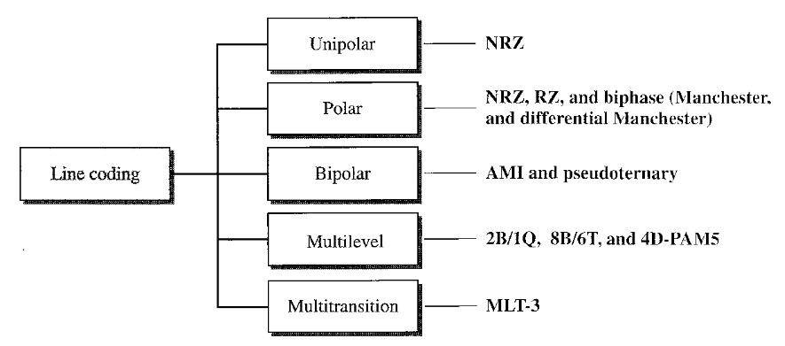
LINE CODING SCHEMES
Notes:
At page 106

Slide 18
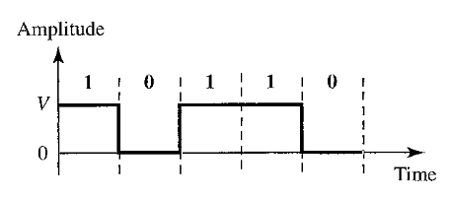
UNIPOLAR
All signal levels are on one side of the time axis.
NRZ (Non Return to Zero)
  Positive → 1
  Zero → 0

Slide 19
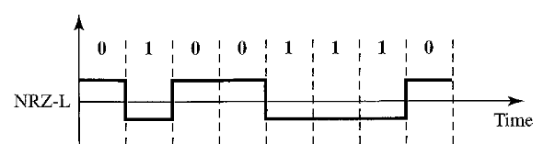
POLAR (NRZ-L)
The voltages are on both sides of the time axis.
NRZ-L (Level)
  The level of the voltage determines the value of the bit
  Negative → 1
  Positive → 0

Slide 20
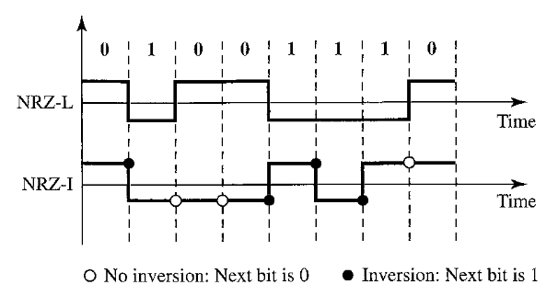
POLAR (NRZ-I)
NRZ-I (Invert)
  The change or lack of change in the level of voltage determines the value of the bit
  Change → 1
  No Change → 0

Slide 21
ANALYSIS OF NRZ-L AND NRZ-I
Baseline wandering is a problem for both variations, however, it is twice as severe in NRZ-L.
If there is a long sequence of Os or ls in NRZ-L, the average signal power becomes skewed. The receiver might have difficulty detecting the bit value.
In NRZ-I this problem occurs only for a long sequence of Os. If somehow we can eliminate the long sequence of Os, we can avoid baseline wandering.

Slide 22
ANALYSIS OF NRZ-L AND NRZ-I (2)
The synchronization problem (sender and receiver clocks are not synchronized) also exists in both schemes.
The main problem with NRZ encoding occurs when the sender and receiver clocks are not synchronized. The receiver does not know when one bit has ended and the next bit is starting.
Again, this problem is more serious in NRZ-L than in NRZ-I. While a long sequence of Os can cause a problem in both schemes, a long sequence of ls affects only NRZ-L.

Slide 23
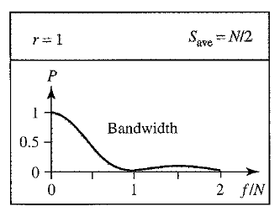
ANALYSIS OF NRZ-L AND NRZ-I (3)
Figure below shows normalized bandwidth for both variations. The vertical axis shows the power density (the power for each 1 Hz of bandwidth); the horizontal axis shows the frequency.
The bandwidth reveals a very serious problem for this type of encoding. The value of the power density is very high around frequencies close to zero. This means that there are DC components that carry a high level of energy.
Most of the energy is concentrated in frequencies between 0 and N/2 and the energy is not distributed evenly between the two halves.

Slide 24
ANALYSIS OF NRZ-L AND NRZ-I (4)
Another problem with NRZ-L occurs when there is a sudden change of polarity in the system.
For example, if twisted-pair cable is the medium, a change in the polarity of the wire results in all Os interpreted as 1 s and all 1 s interpreted as Os.
NRZ-I does not have this problem.

Slide 25
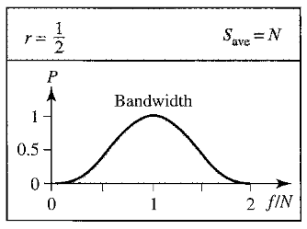
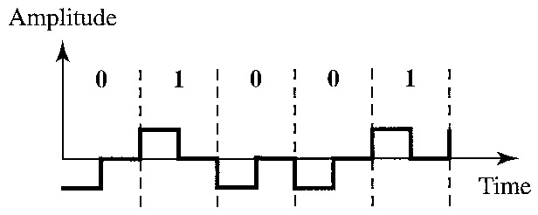
POLAR (RZ)
RZ (Return-to-zero)
  Transition at the middle of the bit. The signal changes not between bits but during the bits.
  Three levels
  High to Low → 1
  Low to High → 0

Slide 26
ANALYSIS OF RZ CODING
The main disadvantage of RZ encoding is that it requires two signal changes to encode a bit and therefore occupies greater bandwidth.
A sudden change of polarity resulting in all Os interpreted as is and all ls interpreted as Os, still exist
There is no DC component problem and it has self-synchronization as there is a transition in the middle of the bit.
Another problem is the complexity: RZ uses three levels of voltage, which is more complex to create and discern.

Slide 27
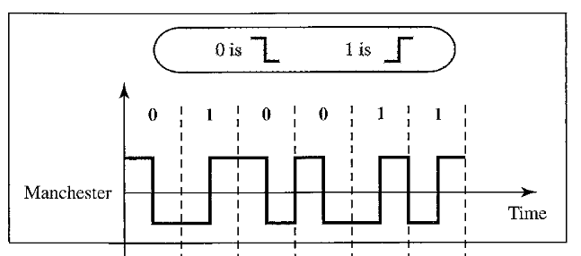
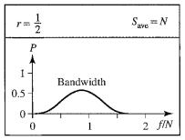
BIPHASE (MANCHESTER)
Manchester
  The idea of RZ (transition at the middle of the bit) and the idea of NRZ-L are combined into the Manchester scheme.
  The transition at the middle of the bit provides synchronization.
  Low to High → 1
  High to Low → 0

Slide 28
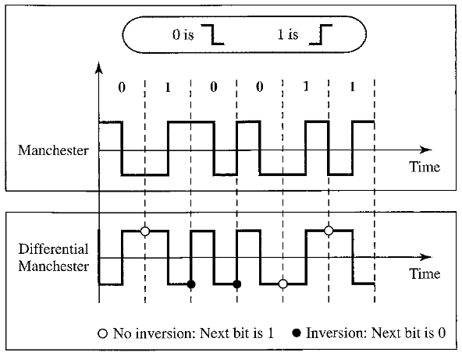
BIPHASE (DIFFERENTIAL MANCHESTER)
Change → 1
No Change → 0

Slide 29
ANALYSIS OF BIPHASE CODING
The Manchester scheme overcomes several problems associated with NRZ-L, and differential Manchester overcomes several problems associated with NRZ-I.
First, there is no baseline wandering.
There is no DC component because each bit has a positive and negative voltage contribution.
It has self synchronization.
The only drawback is the signal rate. The signal rate for Manchester and differential Manchester is double that for NRZ.

Slide 30
BIPOLAR
In bipolar encoding there are three voltage levels: positive, negative, and zero.
The voltage level for one data element is at zero, while the voltage level for the other element alternates between positive and negative.
Two types of bipolar encoding are available
  AMI (Alternate Mark Inversion)
  Pseudoternary
The word mark comes from telegraphy and means 1. So AMI means alternate 1 inversion.
Notes:
AT PAGE 110

Slide 31
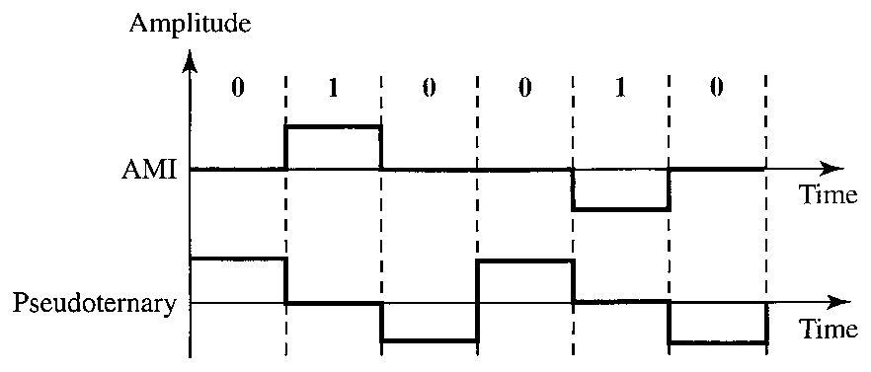
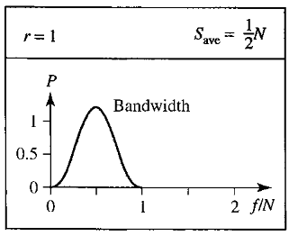
BIPOLAR (AMI & PSEUDOTERNARY)
AMI
  Binary 0 → 0 Voltage
  Binary 1 → Alternating positive and negative voltages
Pseudoternary
  Opposite of AMI

Slide 32
ANALYSIS OF BIPOLAR ENCODING
The bipolar scheme was developed as an alternative to NRZ.
The bipolar scheme has the same signal rate as NRZ, but there is no DC component.
The NRZ scheme has most of its energy concentrated near zero frequency, which makes it unsuitable for transmission over channels with poor performance around this frequency.
The concentration of the energy in bipolar encoding is around frequency N/2.

Slide 33
ANALYSIS OF BIPOLAR ENCODING (2)
One may ask why we do not have DC component in bipolar encoding.
If we have a long sequence of 1s, the voltage level alternates between positive and negative; it is not constant. Therefore, there is no DC component. For a long sequence of Os, the voltage remains constant, but its amplitude is zero, which is the same as having no DC component.
In other words, a sequence that creates a constant zero voltage does not have a DC component.
AMI has a synchronization problem when a long sequence of Os is present in the data.

Slide 34
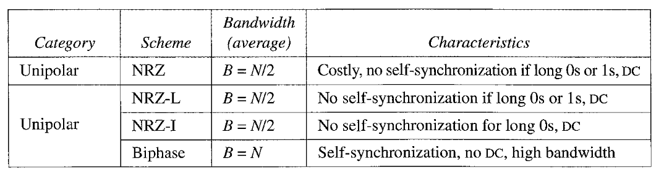
**COMPARISON OF UNIPOLAR AND BIPOLAR

Slide 35
MULTILEVEL
The desire to increase the data speed or decrease the required bandwidth. The goal is to increase the number of data elements and decrease the number of signal elements. (Increase ratio r!)
Multilevel coding is represented as mBnL
  m is the length of the binary pattern (data element)
  B means binary data
  n is the length of the signal pattern (signal element) and
  L is the number of levels in the signaling.
A letter is often used in place of L: B (binary) for L = 2, T (ternary) for L = 3, and Q (quaternary) for L = 4. Note that the first two letters define the data pattern, and the second two define the signal pattern.
Notes:
At page 111

Slide 36
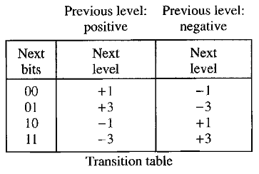
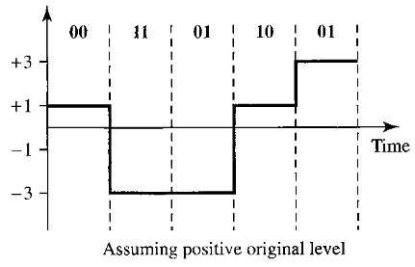
**MULTILEVEL (2B1Q)
2B1Q (Two binary, One quaternary) uses data patterns of size 2 and encodes the 2-bit patterns as one signal element belonging to a four-level signal.

Slide 37
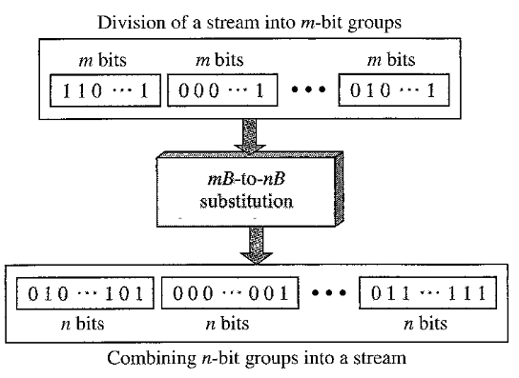
BLOCK CODING
Block coding improves the performance of line coding by using redundancy.
In general, block coding changes a block of m bits into a block of n bits, where n is larger than m.
Block coding is referred to as an mB/nB encoding technique.

Slide 38
BLOCK CODING (2)
Block coding normally involves three steps:
  division, substitution, and combination.
In the division step, a sequence of bits is divided into groups of m bits. For example, in 4B/5B encoding, the original bit sequence is divided into 4-bit groups.
The heart of block coding is the substitution step. In this step, we substitute an m-bit group for an n-bit group. For example, in 4B/5B encoding we substitute a 4-bit code for a 5-bit group.
Finally, the n-bit groups are combined together to form a stream. The new stream has more bits than the original bits.

Slide 39
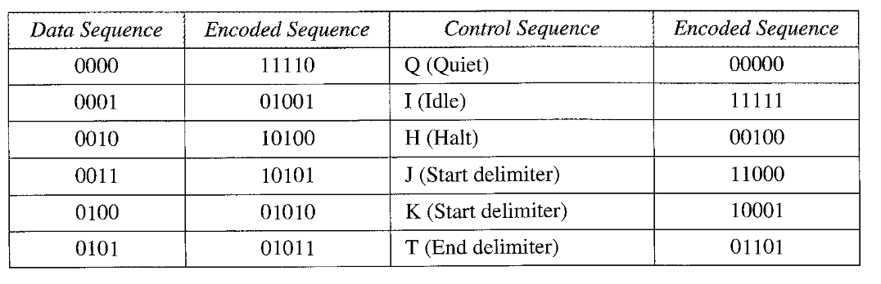
BLOCK CODING 4B/5B (3)

Slide 40
SCRAMBLING
Biphase schemes that are suitable for dedicated links between stations in a LAN are not suitable for long-distance communication because of their wide bandwidth requirement.
The combination of block coding and NRZ line coding is not suitable for long distance encoding either, because of the DC component.
Bipolar AMI encoding, on the other hand, has a narrow bandwidth and does not create a DC component. However, a long sequence of Os upsets the synchronization. If we can find a way to avoid a long sequence of Os in the original stream, we can use bipolar AMI for long distances.

Slide 41
SCRAMBLING
Scrambling provides synchronization without increasing number of bits
We are looking for a solution that substitutes long zero-level pulses with a combination of other levels to provide synchronization.
We modify part of the AMI rule to include scrambling. The system needs to insert the required pulses based on the defined scrambling rules.
Two common scrambling techniques are
  B8ZS and HDB3.

Slide 42
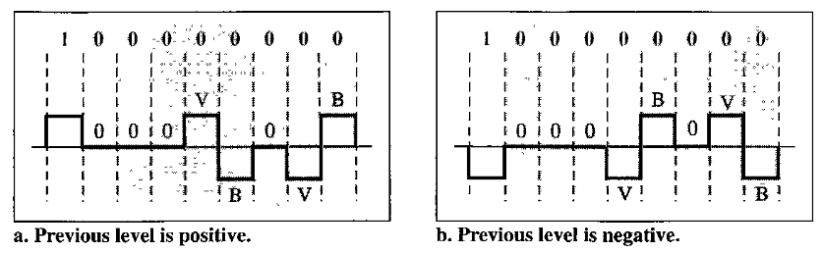
B8ZS (BIPOLAR WITH 8-ZERO SUBSTITUTION)
8 zeros are replaced by the sequence 000VB0VB
The V in the sequence denotes violation; this is a nonzero voltage that breaks an AMI rule of encoding. The B in the sequence denotes bipolar, which means a nonzero level voltage in accordance with the AMI rule.

Slide 43
B8ZS
The letter V (violation) or B (bipolar) here is relative. The V means the same polarity as the polarity of the previous nonzero pulse; B means the polarity opposite to the polarity of the previous nonzero pulse.
Scrambling in this case does not change the bit rate.
Also, the technique balances the positive and negative voltage levels (two positives and two negatives), which means that the DC balance is maintained.

Slide 44
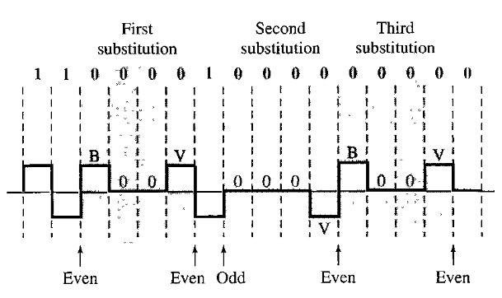
HDB3 (HIGH DENSITY BIPOLAR 3-ZERO)
In HDB3, which is more conservative than B8ZS, four consecutive zero-level voltages are replaced with a sequence of 000V or B00V.

Slide 45
HDB3
The reason for two different substitutions is to maintain the even number of nonzero pulses after each substitution.
The two rules can be stated as follows:
  If the number of nonzero pulses after the last substitution is odd, the substitution pattern will be 000V, which makes the total number of nonzero pulses even.
  If the number of nonzero pulses after the last substitution is even, the substitution pattern will be B00V, which makes the total number of nonzero pulses even.

Slide 46
ANALOG TO DIGITAL CONVERSION
Analog data → Digital data → Digital signal
Two ways
  PCM – Pulse Code Modulation
  DM – Delta Modulation
PCM is the most common technique to change an analog signal to digital (digitization).
PCM has three steps
  Sampling
  Quantization
  Encoding

Slide 47
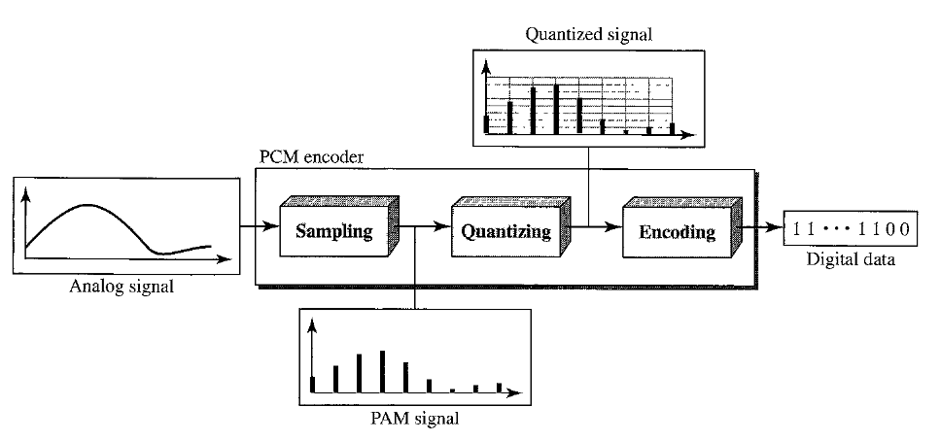
PCM

Slide 48
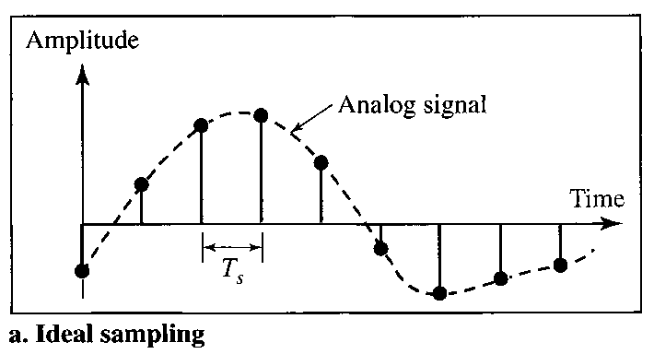
SAMPLING
The analog signal is sampled in every T_{s} seconds, known as sampling period
The inverse of sampling period is called sampling rate or sampling frequency, f_{s} = 1 / T_{s}

Slide 49
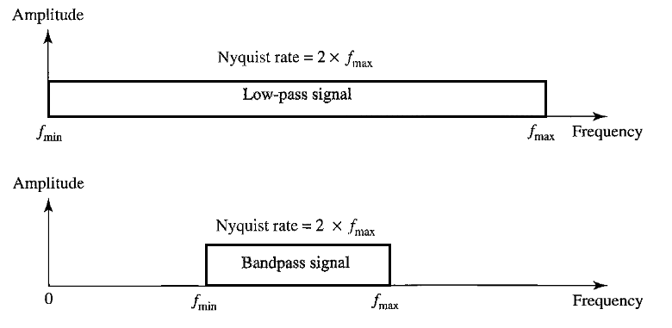
SAMPLING RATE
Nyquist Theorem
  Sampling rate must be at least twice the highest frequency of the signal to reproduce the original analog signal.

Slide 50
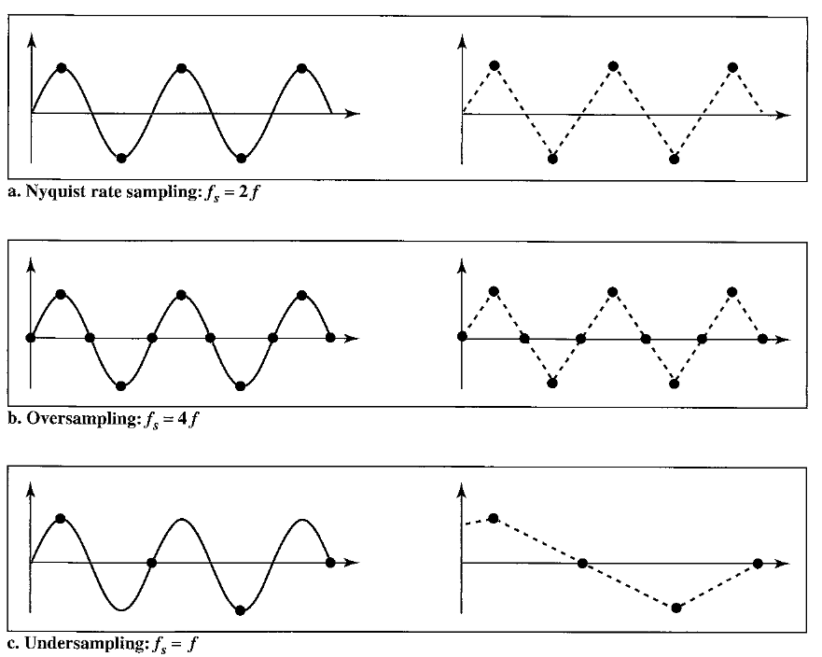
SAMPLING → OVER AND UNDER !

Slide 51
QUANTIZATION
The result of sampling is a series of pulses with amplitude values between the maximum and minimum amplitudes of the signal.
These values cannot be used in the encoding process! Why ?
The following are the steps in quantization:
  Amplitudes are between V_{min} and V_{max}
  This range is divided into L zones, each of height Δ (delta).
  The quantized values of 0 to L - 1 are assigned to the midpoint of each zone.
  The value of the sample amplitude is approximated to the quantized values.

Slide 52
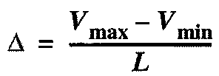
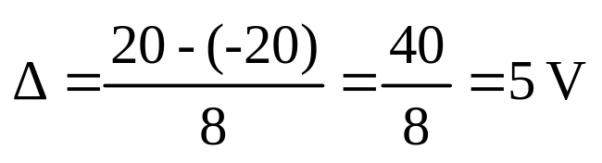
QUANTIZATION (2)
Assume that we have a sampled signal and the sample amplitudes are between -20 and +20 V.
We decide to have eight levels (L = 8).
This means that

Slide 53
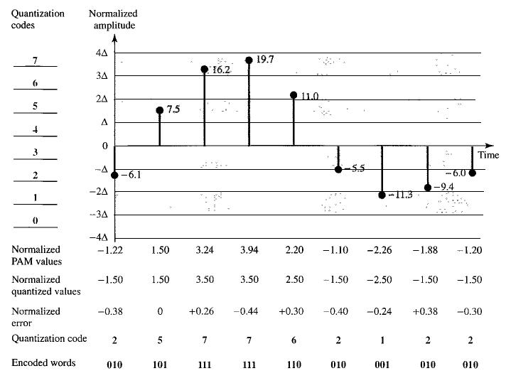
QUANTIZATION (3)

Slide 54
QUANTIZATION (4)
Quantization levels
  In the previous example, eight levels are shown. The choice of levels (L) depends on how accurately we would like to recover the signal
Quantization errors
  Errors are created in the quantization process as quantization is an approximation process.
  The input values to the quantizer are the real values; the output values are the approximated values.
  The output values are chosen to be the middle value in the zone. If the input value is also at the middle of the zone, there is no quantization error; otherwise, there is an error.

Slide 55
ENCODING
After quantization and determining the number of levels, each sample can be changed to an n_{b}-bit code word.
In the Figure of quantization, the encoded words are shown in the last row. A quantization code of 2 is encoded as 010; 5 is encoded as 101; and so on.
The number of bits for each sample is determined from the number of quantization levels. If the number of quantization levels is L, the number of bits is n_{b} = Log₂ L.
In our example L is 8 and n b is therefore 3. The bit rate can be found from the formula

Slide 56
ORIGINAL SIGNAL RECOVERY
The recovery of the original signal requires the PCM decoder.
The decoder first uses circuitry to convert the code words into a pulse that holds the amplitude until the next pulse.
After the staircase signal is completed, it is passed through a low-pass filter to smooth the staircase signal into an analog signal.
If the signal has been sampled at (or greater than) the Nyquist sampling rate and if there are enough quantization levels, the original signal will be recreated.

Slide 57
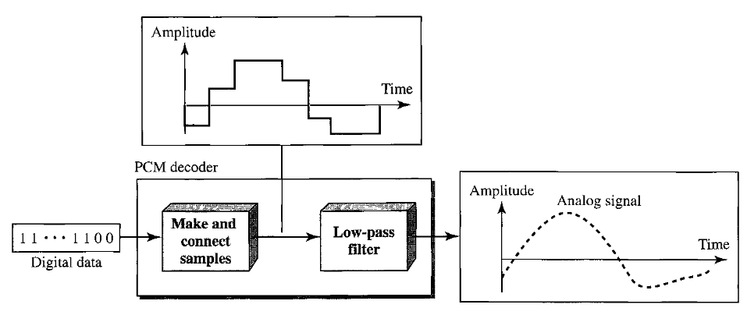
ORIGINAL SIGNAL RECOVERY (2)

Slide 58
DELTA MODULATION
Delta modulation is simpler than the complex PCM.
PCM finds the value of the signal amplitude for each sample; whereas DM finds the change from the previous sample.
Note that there are no code words here; bits are sent one after another.
The modulator is used at the sender site to create a stream of bits from an analog signal.
The quantization error of DM, however, is much less than that for PCM.

Slide 59
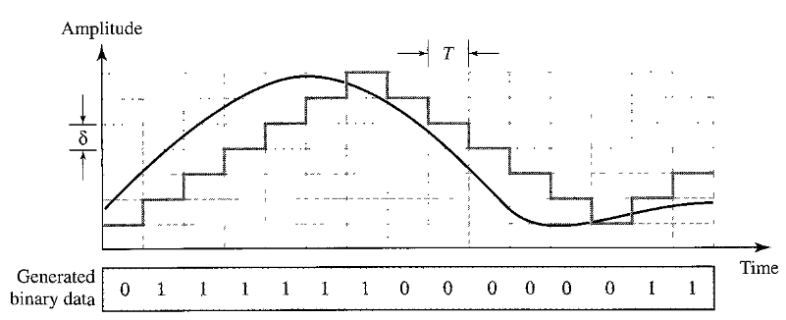
DM
The process records the small positive or negative changes, called delta
If the delta is positive, the process records a 1;
If the delta is negative, the process records a 0.

Slide 60
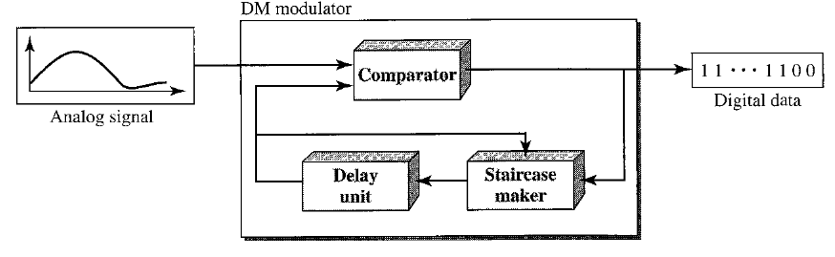
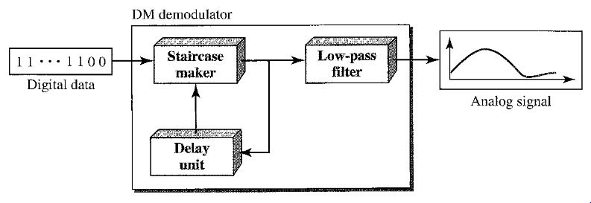
DM COMPONENTS

Slide 61
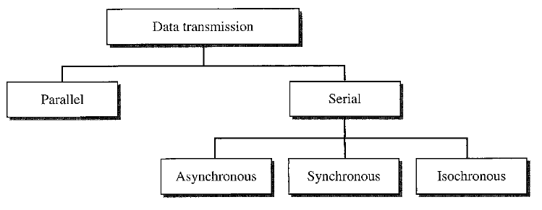
TRANSMISSION MODES

Slide 62
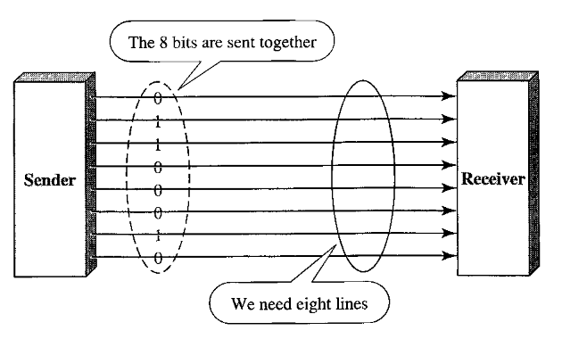
PARALLEL TRANSMISSION
In parallel mode, a group of bits are sent with each clock tick.
The advantage of parallel transmission is speed.
All else being equal, parallel transmission can increase the transfer speed by a factor of n over serial transmission

Slide 63
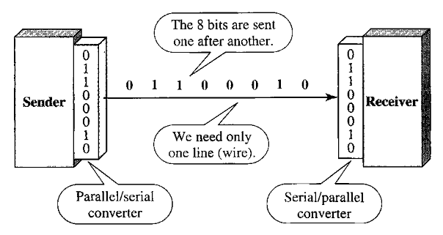
SERIAL TRANSMISSION
In serial mode, 1 bit is sent with each clock tick. In serial transmission one bit follows another, so we need only one communication channel rather than n
The advantage of serial over parallel transmission is that with only one communication channel, serial transmission reduces the cost of transmission over parallel by roughly a factor of n.

Slide 64
SERIAL COMMUNICATION (2)
Since communication within devices is parallel, conversion devices are required at the interface in both the cases (Refer to the Figure in the last slide)
  between sender and communication line (parallel-to-serial)
  between communication line and receiver (serial-to-parallel)
Serial transmission occurs in one of three ways:
  Asynchronous,
  Synchronous, and
  Isochronous.

Slide 65
ASYNCHRONOUS TRANSMISSION
Asynchronous transmission is so named because the timing of a signal is unimportant.
Instead, information is received and translated by agreed upon patterns. As long as those patterns are followed, the receiving device can retrieve the information.
Without synchronization, the receiver cannot use timing to predict when the next group will arrive. To alert the receiver to the arrival of a new group, therefore, an extra bit is added to the beginning of each byte.
This bit, usually a 0, is called the start bit. To let the receiver know that the byte is finished, 1 or more additional bits are appended to the end of the byte. These bits, usually 1 s, are called stop bits.

Slide 66
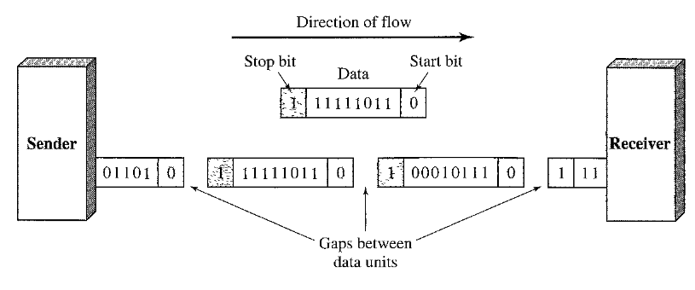
ASYNCHRONOUS TRANSMISSION
By this method, each byte is increased in size to at least 10 bits, of which 8 bits is information and 2 bits or more are signals to the receiver.
There may be gap in between the bytes. This gap can be represented either by an idle channel or by a stream of additional stop bits.
Asynchronous at byte level, but bits are still synchronized; Their durations are same.

Slide 67
SYNCHRONOUS TRANSMISSION
In synchronous transmission, the bit stream is combined into longer "frames," which may contain multiple bytes.
Each byte, however, is introduced onto the transmission link without a gap between it and the next one.
It is left to the receiver to separate the bit stream into bytes for decoding purposes.
In other words, data are transmitted as an unbroken string of 1 s and Os, and the receiver separates that string into the bytes, or characters, it needs to reconstruct the information.

Slide 68
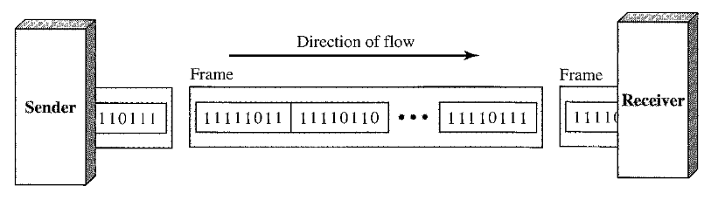
SYNCHRONOUS TRANSMISSION
We send bits after one another without start or stop bits or gaps
It is the responsibility of the receiver to decode the bits into bytes

Slide 69
ISOCHRONOUS TRANSMISSION
Uneven delays are not acceptable in real time audio and video, synchronous transmission fails here.
For example, TV images are broadcast at the rate of 30 images per second; they must be viewed at the same rate. If each image is sent by using one or more frames, there should be no delays between frames.
For this type of transmission, synchronization between bits is not enough, rather the entire stream must be synchronized
Isochronous transmission guarantees that data will arrive at a fixed rate

